Slide 2
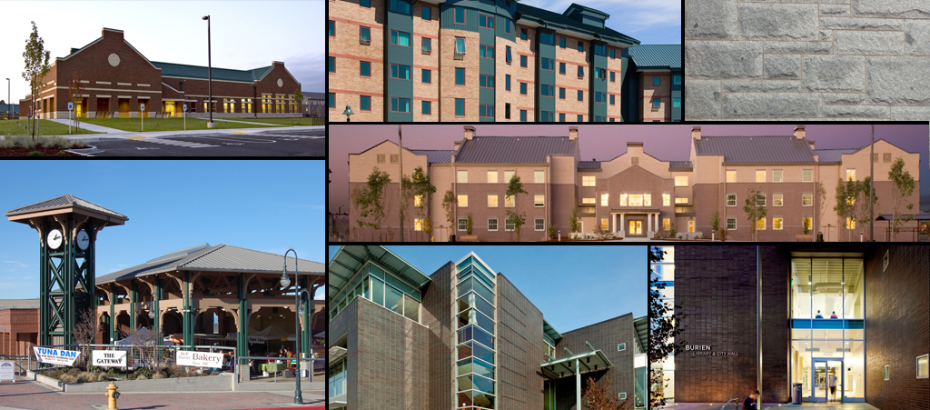
Community Planning – Designing with Masonry
AIA Continuing Education
1.5 CEU (SD & HSW)

Slide 3
Jessica Ibanez
Community planning consultant with the Colorado Brick Council’s Local Government Outreach Program.
Experience working with local government.
Member of the American Institute of Certified Planners.

Slide 4
The Masonry Institute of Washington is a Registered Provider with The American Institute of Architects Continuing Education Systems. Credit earned on completion of this program will be reported to CES Records for AIA members. Certificates of Completion for non-AIA members are available upon request.
This program is registered with the AIA/CES for continuing professional education. As such, it does not include content that may be deemed or construed to be an approval or endorsement by the AIA of any material of construction or any method or manner of handling, using, distributing, or dealing in any material or product. Questions related to specific materials, methods, and services will be addressed at the conclusion of this presentation.

Slide 5
Learning Objectives
Masonry Planning Policy Methods
Community Benefits of Masonry Based Design
Case Study Communities
Masonry Planning Policy Examples

Slide 7
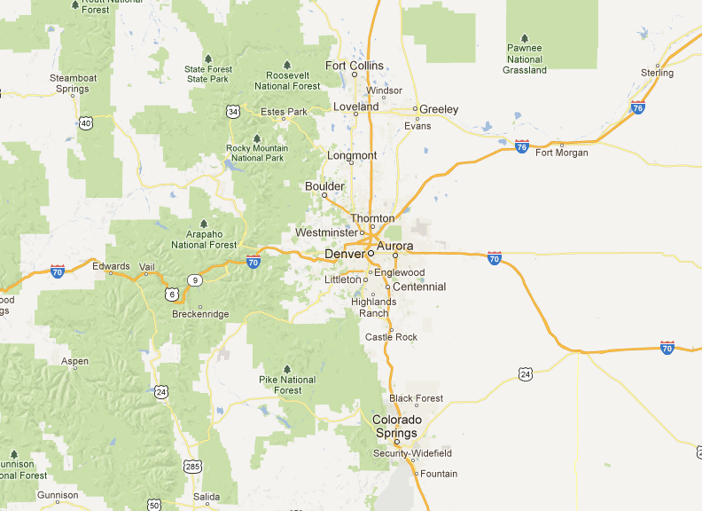
google.com/maps

Slide 8
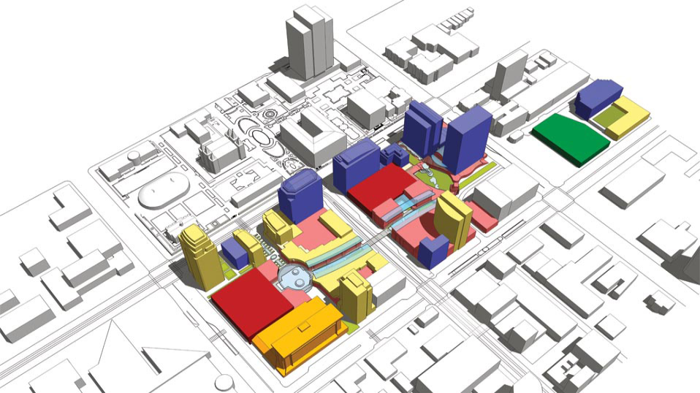
Why is design policy necessary?

Slide 9
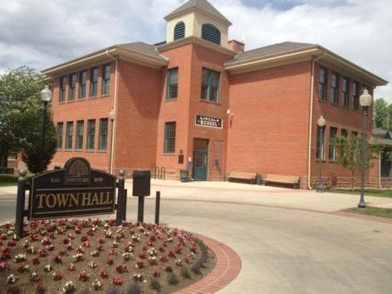
Erie, CO

Slide 10
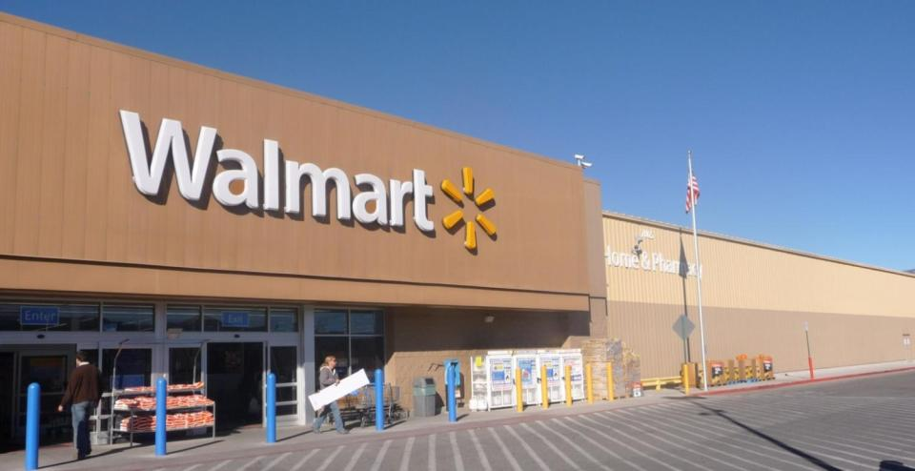

Slide 11
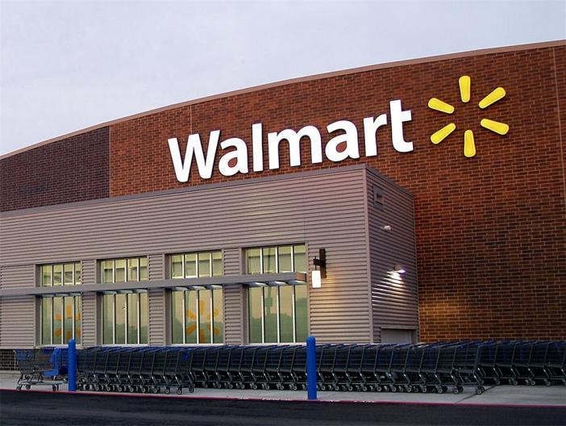
What is masonry based design policy?
www.walmart.com

Slide 12
Implementation Techniques
Zoning Ordinance
Overlay Districts
Design Guidelines
Planned Unit Developments
Form Based Code
Incentive Based

Slide 13
Implementation Techniques
Gateway
Corridor
Zoning District
Historic District
google.com/maps

Slide 14
Why regulate design?
Fashion or Function

Slide 15
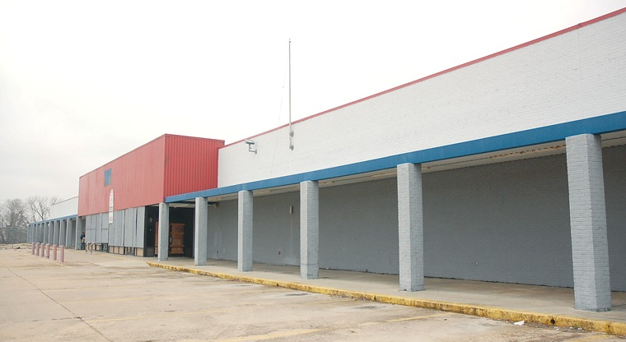

Slide 16
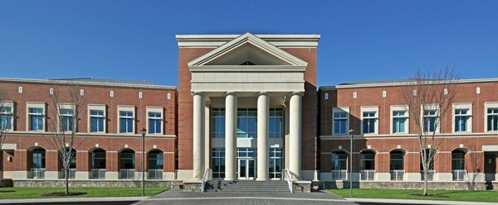
Misconceptions

Slide 17
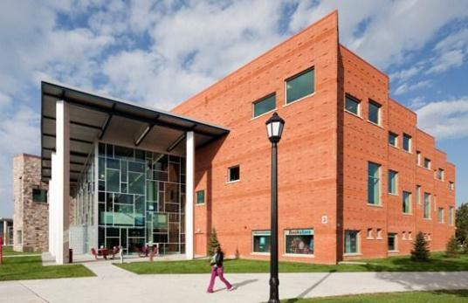
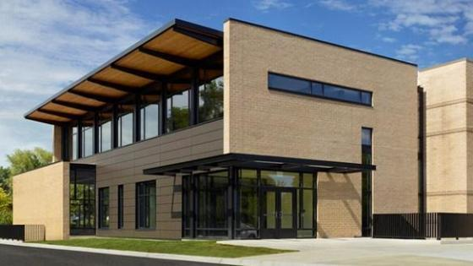
Misconceptions

Slide 18
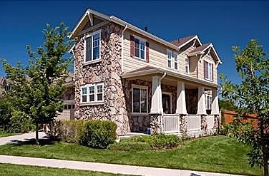
Misconceptions

Slide 19
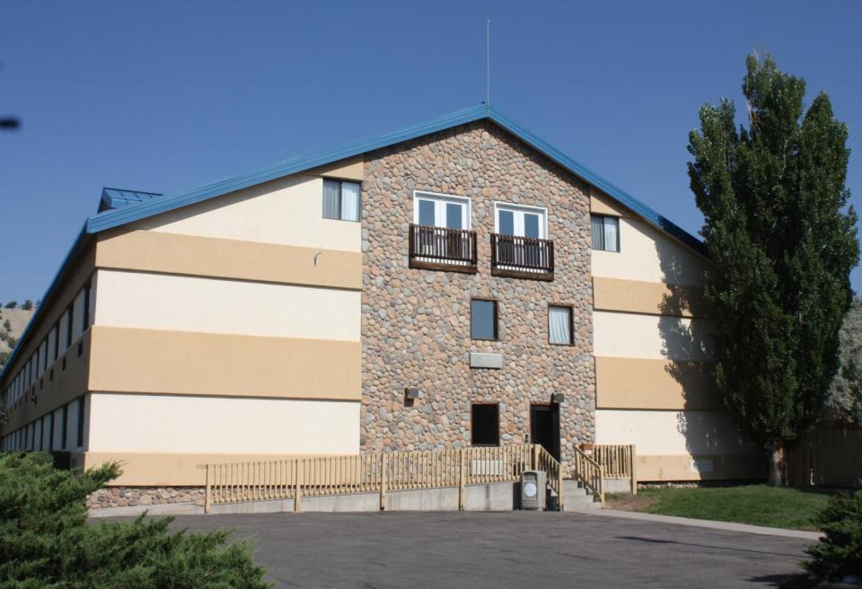
Misconceptions

Slide 20
Benefits of Masonry Based Design Policy

Slide 21
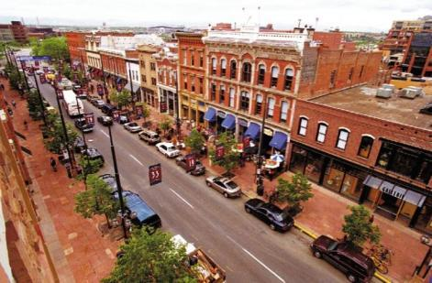
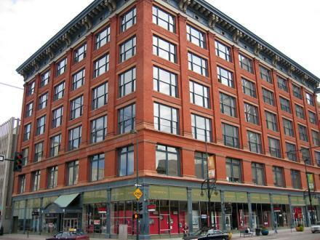
Public Safety

Slide 22
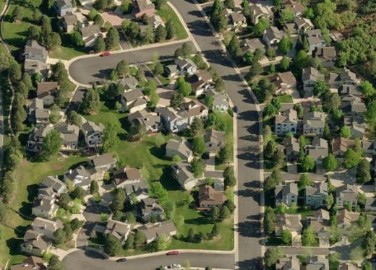
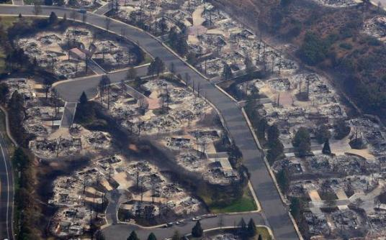
Waldo Canyon Fire
Colorado Springs
Photo by RJ Sangosti
The Denver Post

Slide 23
Lowry (Denver/Aurora, CO) Redevelopment

Slide 24
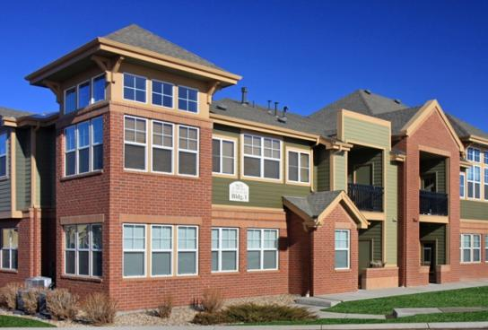
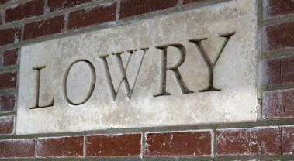
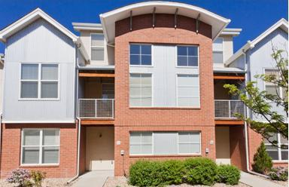
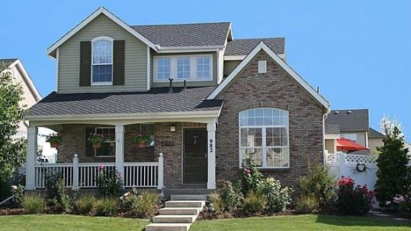
Lowry (Denver/Aurora, CO) Redevelopment

Slide 25
Orland Park, IL

Slide 26
University of Michigan Study
Property Values Taxes Growth Affordability

Slide 27
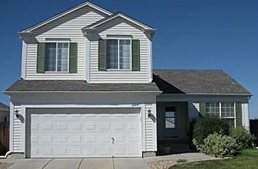
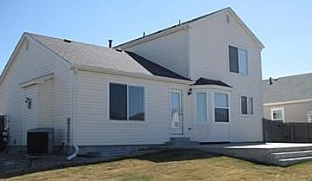
Aurora, CO

Slide 28
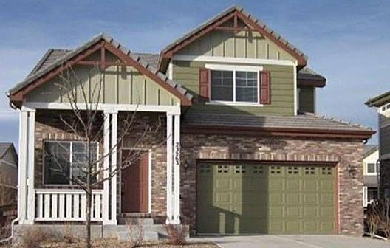
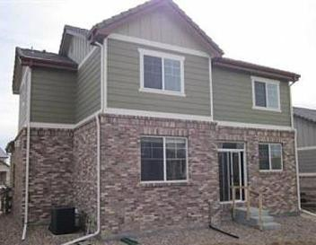
Aurora, CO

Slide 29
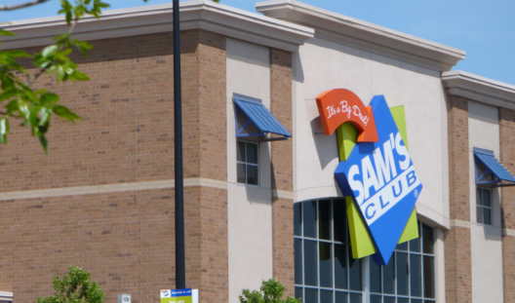
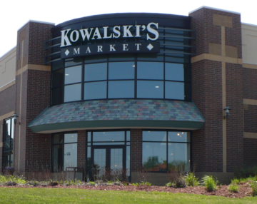
Woodbury, MN

Slide 30
Woodbury, MN
Class I
a. Fired clay brick
b. Natural stone
c. Glass
d. Copper panels
e. Other comparable/superior materials
Class II
a. Specialty concrete block
b. Architecturally precast textured concrete panels
c. Masonry stucco
d. Other comparable/superior materials
Class III
a. Exterior finish installation system (EFIS)
b. Opaque panels
c. Ornamental metal
Class IV
a. Smooth concrete block
b. Smooth scored concrete block
c. Smooth concrete tip up panels
d. Ceramic
e. Glass block
f. Wood
a. Office and commercial buildings must use at least three (3) class I materials and must be composed of at least sixty-five (65) percent class I materials; not more than thirty-five (35) percent class II or class III material and not more than ten (10) percent class IV materials.
b. Industrial and warehouse buildings must use at least two (2) different class I or II materials and be composed of at least sixty-five (65) percent class I or class II; not more than thirty-five (35) percent of class III or class IV materials. Not more than ten (10) percent of the building shall be class IV materials.

Slide 31
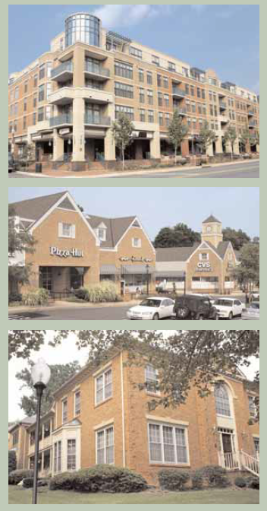
Falls Church, VA
Falls Church, VA
1. Masonry is the most appropriate material for commercial buildings.
2. Use consistent materials on all sides of a building.
3. Use material, texture and color changes to help reduce mass and provide visual interest but also avoid overly busy designs.

Slide 32
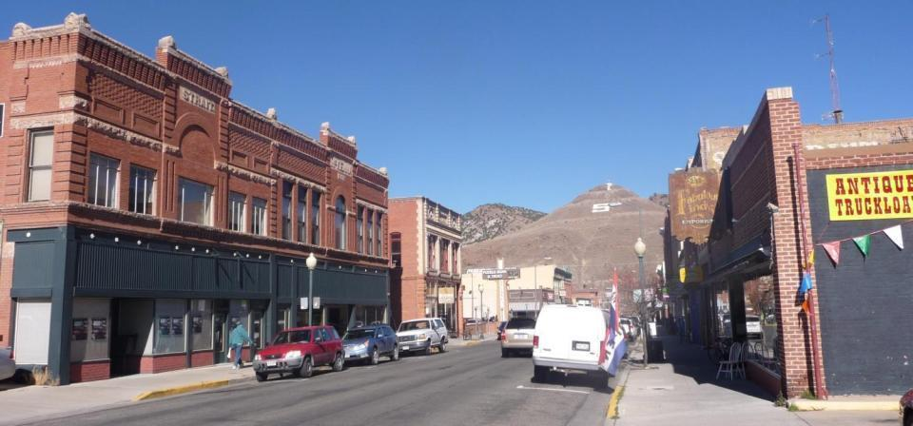
Salida, CO

Slide 33
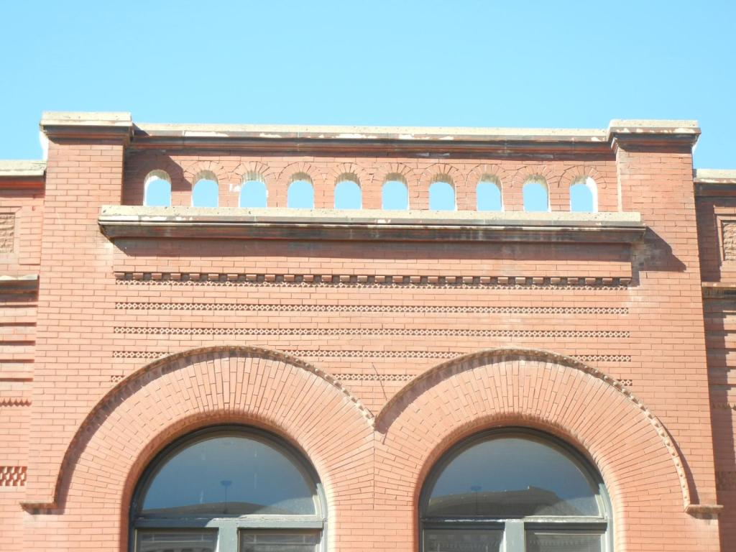

Slide 34
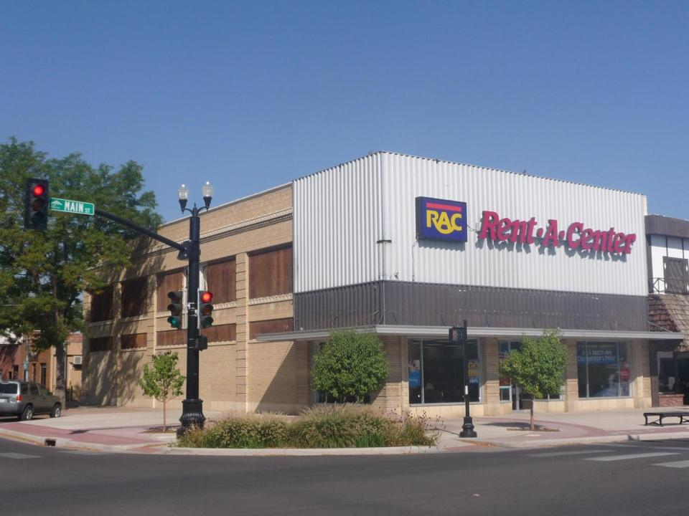

Slide 35
Salida, CO
Preserve original building materials. Masonry features that define the overall historic character, such as walls, cornices, pediments, steps and foundations, should be preserved. •
Do not use synthetic materials, such as aluminum or vinyl siding or panelized brick, as replacements for primary building materials.
Primary building materials, such as wood, metal, and brick, should not be replaced or covered with synthetic or panelized materials.

Slide 36
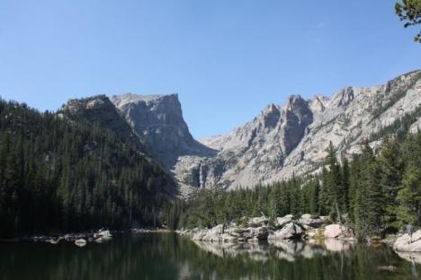
Natural Materials
Building Materials and Colors
(i) The use of high quality, durable building materials is required. Exterior
walls shall be finished with materials used in a manner sympathetic to the scale and
architectural style of the building.
(ii) Preferred materials reflect the Town’s sub alpine character such as native
stone, wood siding, masonry or timbers.
(iii) The following building materials and wall finishes are not permitted on the
exterior of any structure:
(A) asphalt siding,
(B) imitation brick,
(C) asbestos cement shingles or siding,
(D) imitation log siding, or
(E) plastic or vinyl siding.

Slide 37
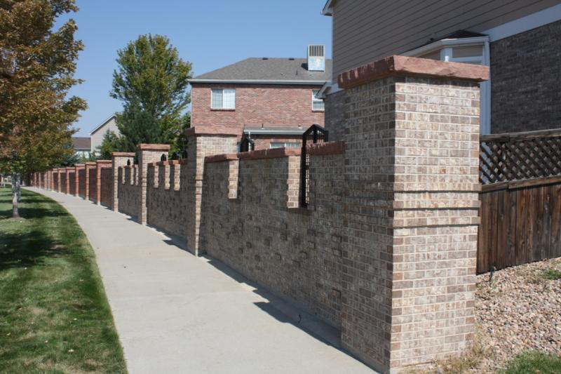
Creating Public Amenities

Slide 38
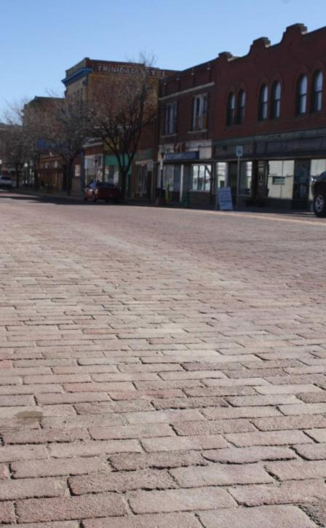
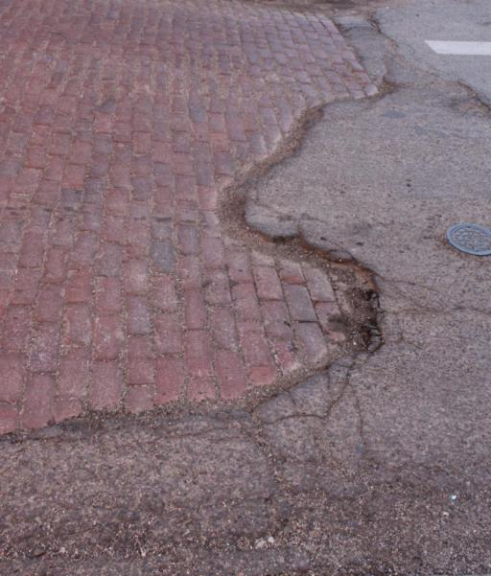
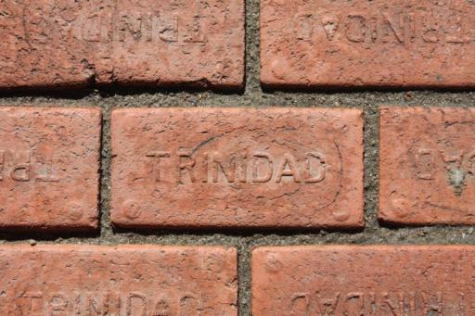
Creating Public Spaces

Slide 39
QUESTIONS?
Source and Photo Credit:
Brick Industry Association (www.gobrick.com)

